Slide 1
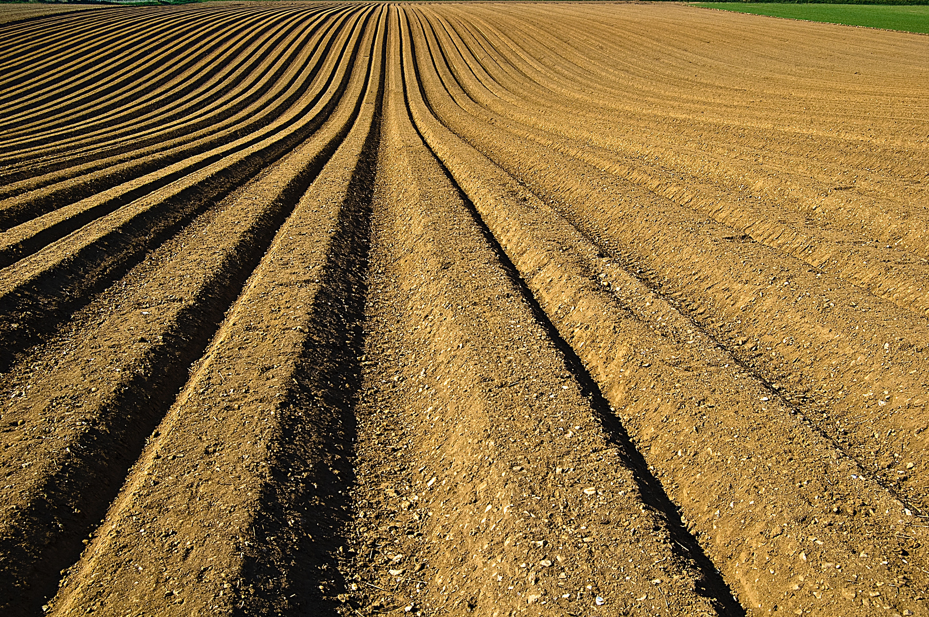

Metagenome sequencing USDA ARS Microbiome Workshop August 30, 2017 Adam R. Rivers

Slide 2
Hello!
The Genomics and Bioinformatics Unit
Brian Scheffler – Research leader
Stoneville, Mississippi
Brian.Scheffler@ars.usda.gov
Adam Rivers – SY Microbiomes and microbial genomes
Gainesville, Florida
Adam.Rivers@ars.usda.gov
Justin Vaughn – SY Crop Genetics
Athens, Georgia
Justin.Vaughn@ars.usda.gov
Amanda Hulse-Kemp – SY Complex and Polyploid Genomes
Raleigh, North Carolina
Amanda.Hulse-Kemp@ars.usda.gov

Slide 3
Learning Objectives
By the end the training you should
What questions metagenomics can address
Know how metagenome samples are processed
Understand an assembly-based bioinformatics workflow
Know the types of analyses are possible with metagenomics.

Slide 4

1.
What is metagenome sequencing?

Slide 5
Metagenome sequencing
“Metagenome sequencing is the random sequencing of genomic material from a mixed group of organisms, including natural communities, enrichments and co-cultures. ”
Short read
PE Illumina
SE Illumina
Nextera
Swift ss/dsDNA
Reverse transcription for RNA viruses
MDA
Long read
PacBio
X10 Genomics
Oxford Nanopore
Dovetail Genomics
Fractionated
SIP
Crosslinked - Phase genomics

Slide 6
Metagenomics and Hypothesis driven science
“Which comes first the experiment or the model is the same as which came first the chicken or the egg. The answer is they co-evolve.”
-Neil Lawrence paraphrasing Karl Popper’s The problem on induction
Questions drive the collection of metagenomics data but hypotheses are often generated and tested after data collection.
Notes:
Questions drive the collection of metagenomics data but but hypotheses are generated and tested after data collection. This is becoming common and much od data science deals with data not collected for one specific purpose as in traditional experimental design. Is this valid science . Yes. But, there is a danger here. We can generate a huge range of hypotheses looking at the data and test until we find a set of compelling statistically significant ones. Because these comparisons were not formal tests we have not corrected for false discovery rates. Metagenomics even more so than other methods in science well requires you to hold a hypotheses up, but not get too comfortable with it. Be willing to reject it.We willing to write a less interesting paper that is better supported by the data.

Slide 7

2.
What can metagenomics answer?
Who lives here and what can they do?

Slide 8
Taxonomic composition
Eren et al. 2015

Slide 9
Genome reconstruction
Kang et al. 2015

Slide 10
Functional annotation and Metabolic pathway construction
Metabolic capacity for Candidate phyla radiation bacterium Parcunitrobacter nitroensis
Castelle et al. 2017

Slide 11
Functional gene phylogeny
Rivers et al. 2013

Slide 12
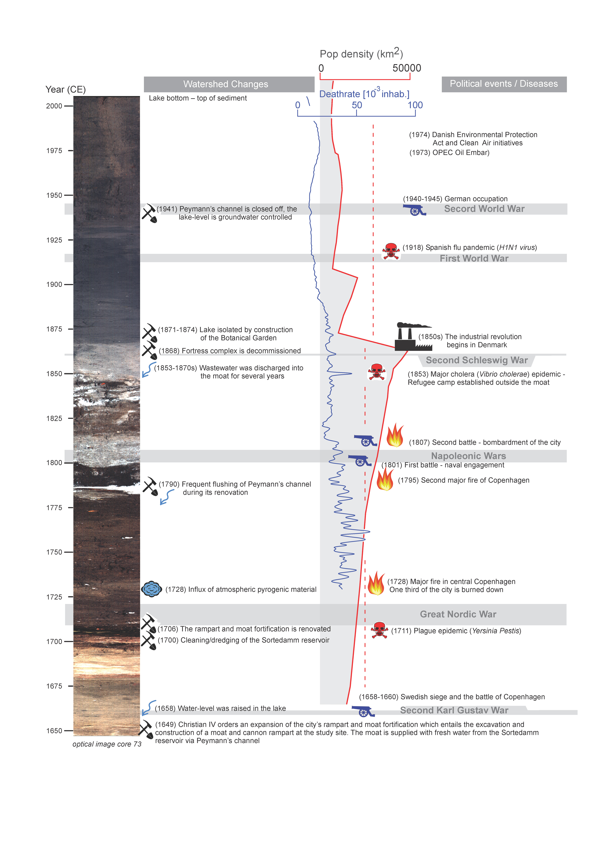
Historical reconstruction
(Pedersen et al. In review)

Slide 13
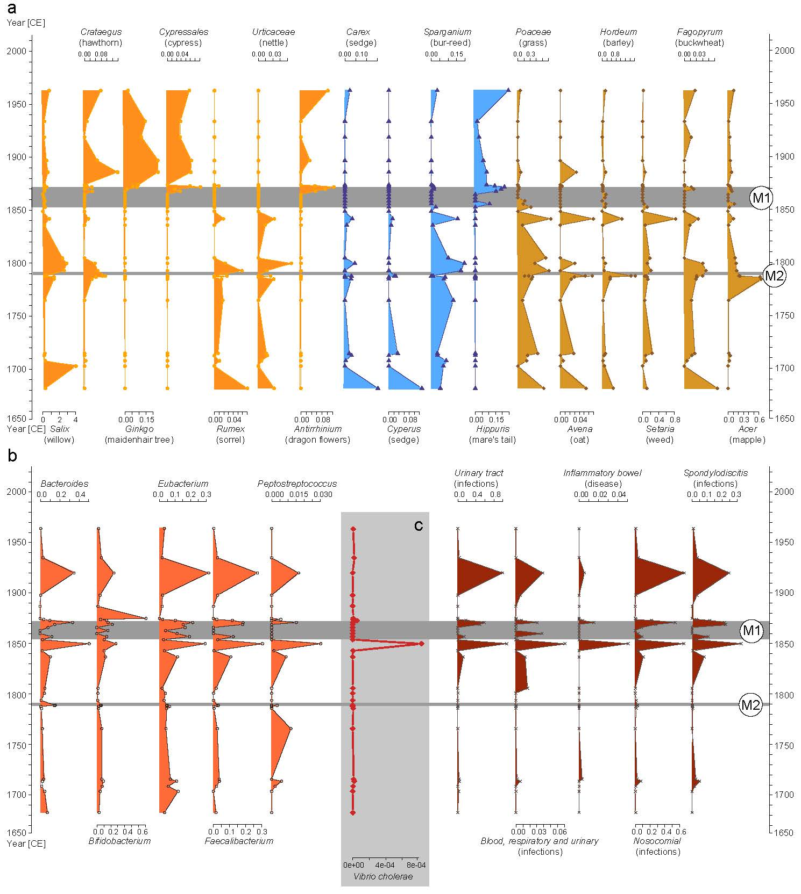
Historical reconstruction
(Pedersen et al. In review)

Slide 14
Population structure

Slide 15
3.
Field to sequencer – the nuts and bolts.
Sample preparation and sequencing

Slide 16
Collect DNA
Metagenome DNA sampling is more forgiving than RNA sampling but care must be taken to prevent degradation, especially for long read technologies.
4ºC Short-term
-20ºC Long-term
(Rubin et al. 2013)
Collect and store
within 1 hour
Extract as soon as practical
Consider collecting RNA and storing it in RNAlater (saturated ammonium sulfate) at 4ºC until extraction. Metatransctiptomics can answer new questions.

Slide 17
Collect Metadata
“There is no such thing as metadata, everything is data.”
- Susan Holmes
Sample collection is the time to record environmental data
The GSC has created environmental and sequence data standards, MIxS. Use them as a guide for your collections.
Store environmental data in NCBI or ENA Biosamples databases or Gold database. Do it now, while you still remember what you did. You can link sequence data later.

Slide 18
DNA extraction
Target amount of DNA for Illumina sequencing:
1 µg at 20-50 ng/ul in 10-50 ul
About 200ng is needed for Truseq.
10 ng for Netxera and Swift.*
Target amount of DNA for long read sequencing:
1-5 µg at 50-500 ng/ul in 10-100 ul
* These kits go to ~50 pg but but going below a few ng is a great
way to accidentally sequence yourself or your pets

Slide 19
DNA extraction
Extraction kits vary by sample type
MoBio (now Qiagen) kits have been very popular
Phenol-chloroform and TRIsol extractions yield good results in experienced hands
Long read sequencing requires special extractions
Fosmid methods
PFGE
No sonication, French press or bead beating!
All extractions are selective
There is a tradeoff between DNA quality and bias
Multi-enzyme cocktails are now available

Slide 20
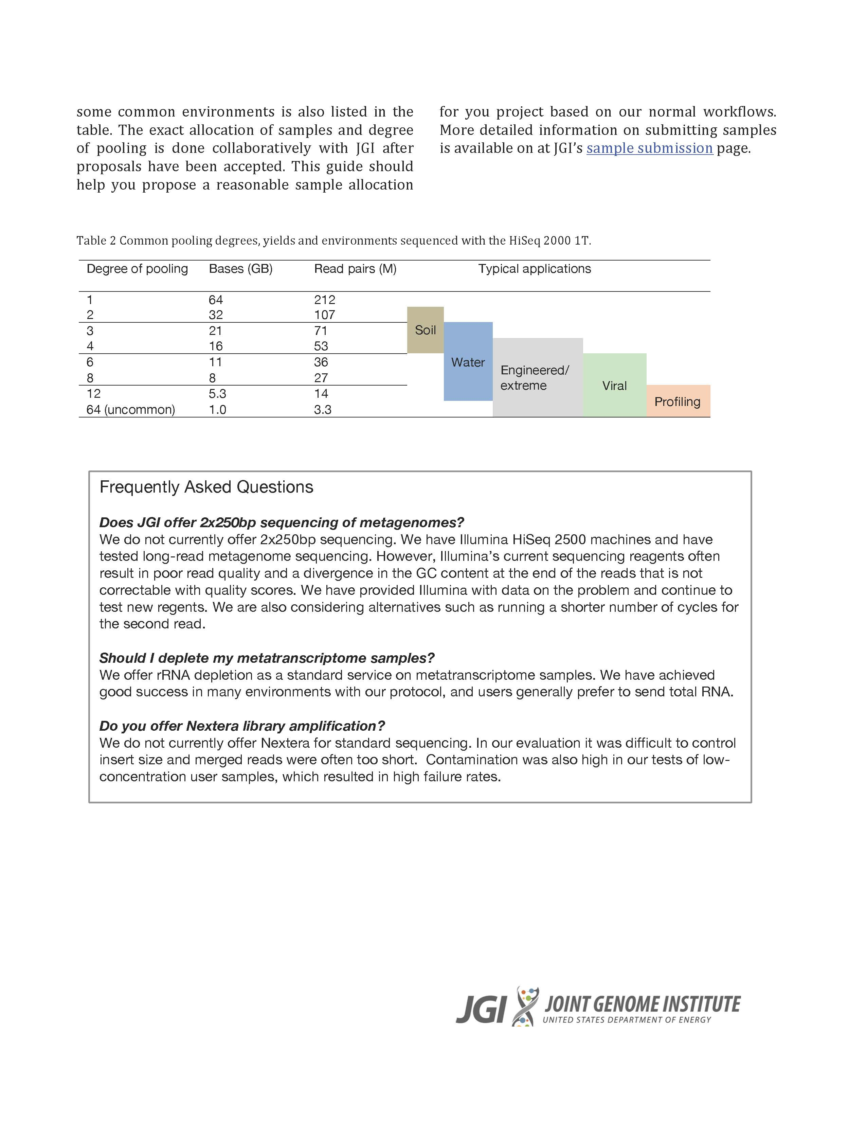
How much sequence is needed?
Kmer based estimates of coverage can be made
Fraction of data at of over depth

Slide 21
4.
Analysis of metagenomedata
GATC
CATC
CCGA
What to do with all those fastq.gz files.

Slide 22
Metagenomic sequencing
Read-Based
Focused on functional and taxonomic composition
GATC
Assembly-Based
Useful for pathway analysis, phylogenetics
Detection-based
Primarily for pathogen detection

Slide 23
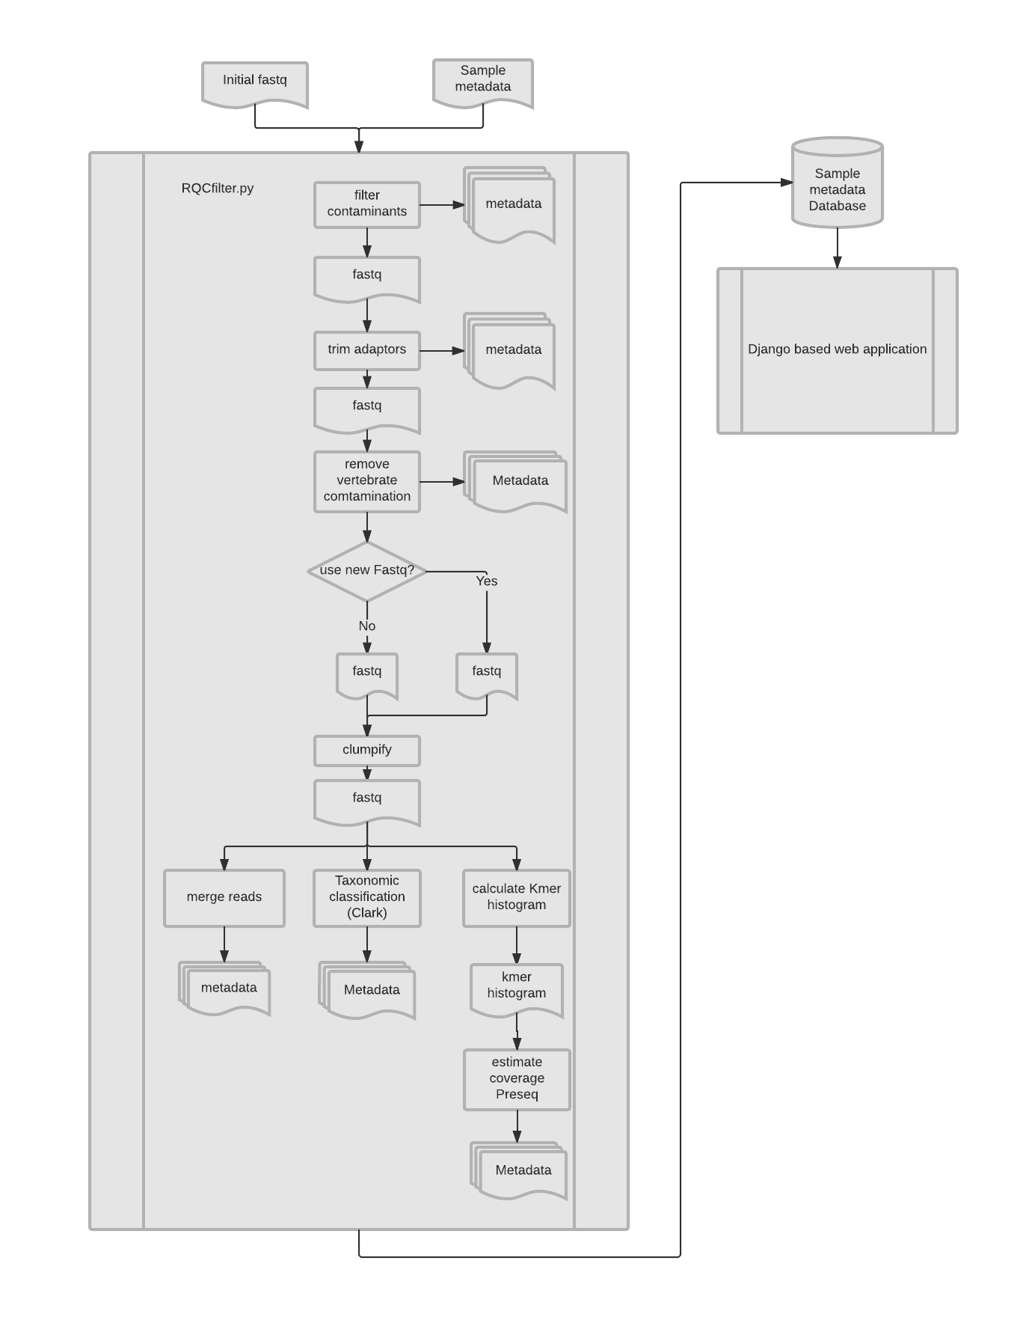
Quality Control
Demo of QC application

Slide 24
Taxonomic composition
Read identification
Read based approaches require rapid methods
Kmer based matching
Clarke, Kraken
BWA/FM indexed based
Centrifuge
Accelerated gapped alignment
Diamond/ Megan
Database selection is key
Precision-recall should be considered
Gene based identification
First gene calling is run
Metagenemark, Prodigal
Full length genes increase accuracy
Data reduction allows for more sensitive methods:
Hmmer,
Gapped alignment (LAST, RapSearch)
Determining the level to classify at is a challenge for all algorithms

Slide 25
Metagenome binning –genome reconstruction
Metagenome binning is the clustering of contigs into bins that originate from a single genome.
Input data used:
4-mer frequencies
Abundance profiles
Common tools:
Metabat
Maxbin2
Concoct
ABAWACA
ESOM
Quality assessment
CheckM

Slide 26
Metagenome binning –genome reconstruction
Growth in metagenome assembled genomes (MAG’s)
Quality standards are now available

Slide 27
Functional annotation
Functional databases/ontologies
Protein families
Pfam
Superfamily
eggNog
Metabolic pathways
Kegg
SEED
MetaCyc
Antibiotic Resistance
CARD
ARDB
Virulence
MvirDB
PATRIC
vFAM
VFDB
Victors
Carbohydrates
dbCAN
Mobile genetic elements
ICEberg
Prophages
Cross-mapping does seem to work (Kultima et al. 2016)

Slide 28
Functional Gene phylogeny
Select reference gene family
Search for contig homologs (HMMER)
Build MSA (MAFFT) and HMM
Select regions (TrimAL)
Test phylogenetic models
Build ML Tree
Search then Align Reads with HMMER
Read placement (Pplacer, EPA)

Slide 29
Tutorial time
Assembly-based metageomics workflows can be found at the ARS microbiome workshop website.
Tutorial 1: Raw data to assembly and mapping
Tutorial 2: Annotation, binning and exploration with Anvi’o

Slide 30
Photo credits
1: DNA - Made By MadeByOliver from Flaticon.com
1: Tilled field Photo by Zbysiu Rodak on Unsplash
3. Rice paddies Photo by Doan Tuan on Unsplash
Crowded Photo by denis ng on Unsplash

